Slide 1
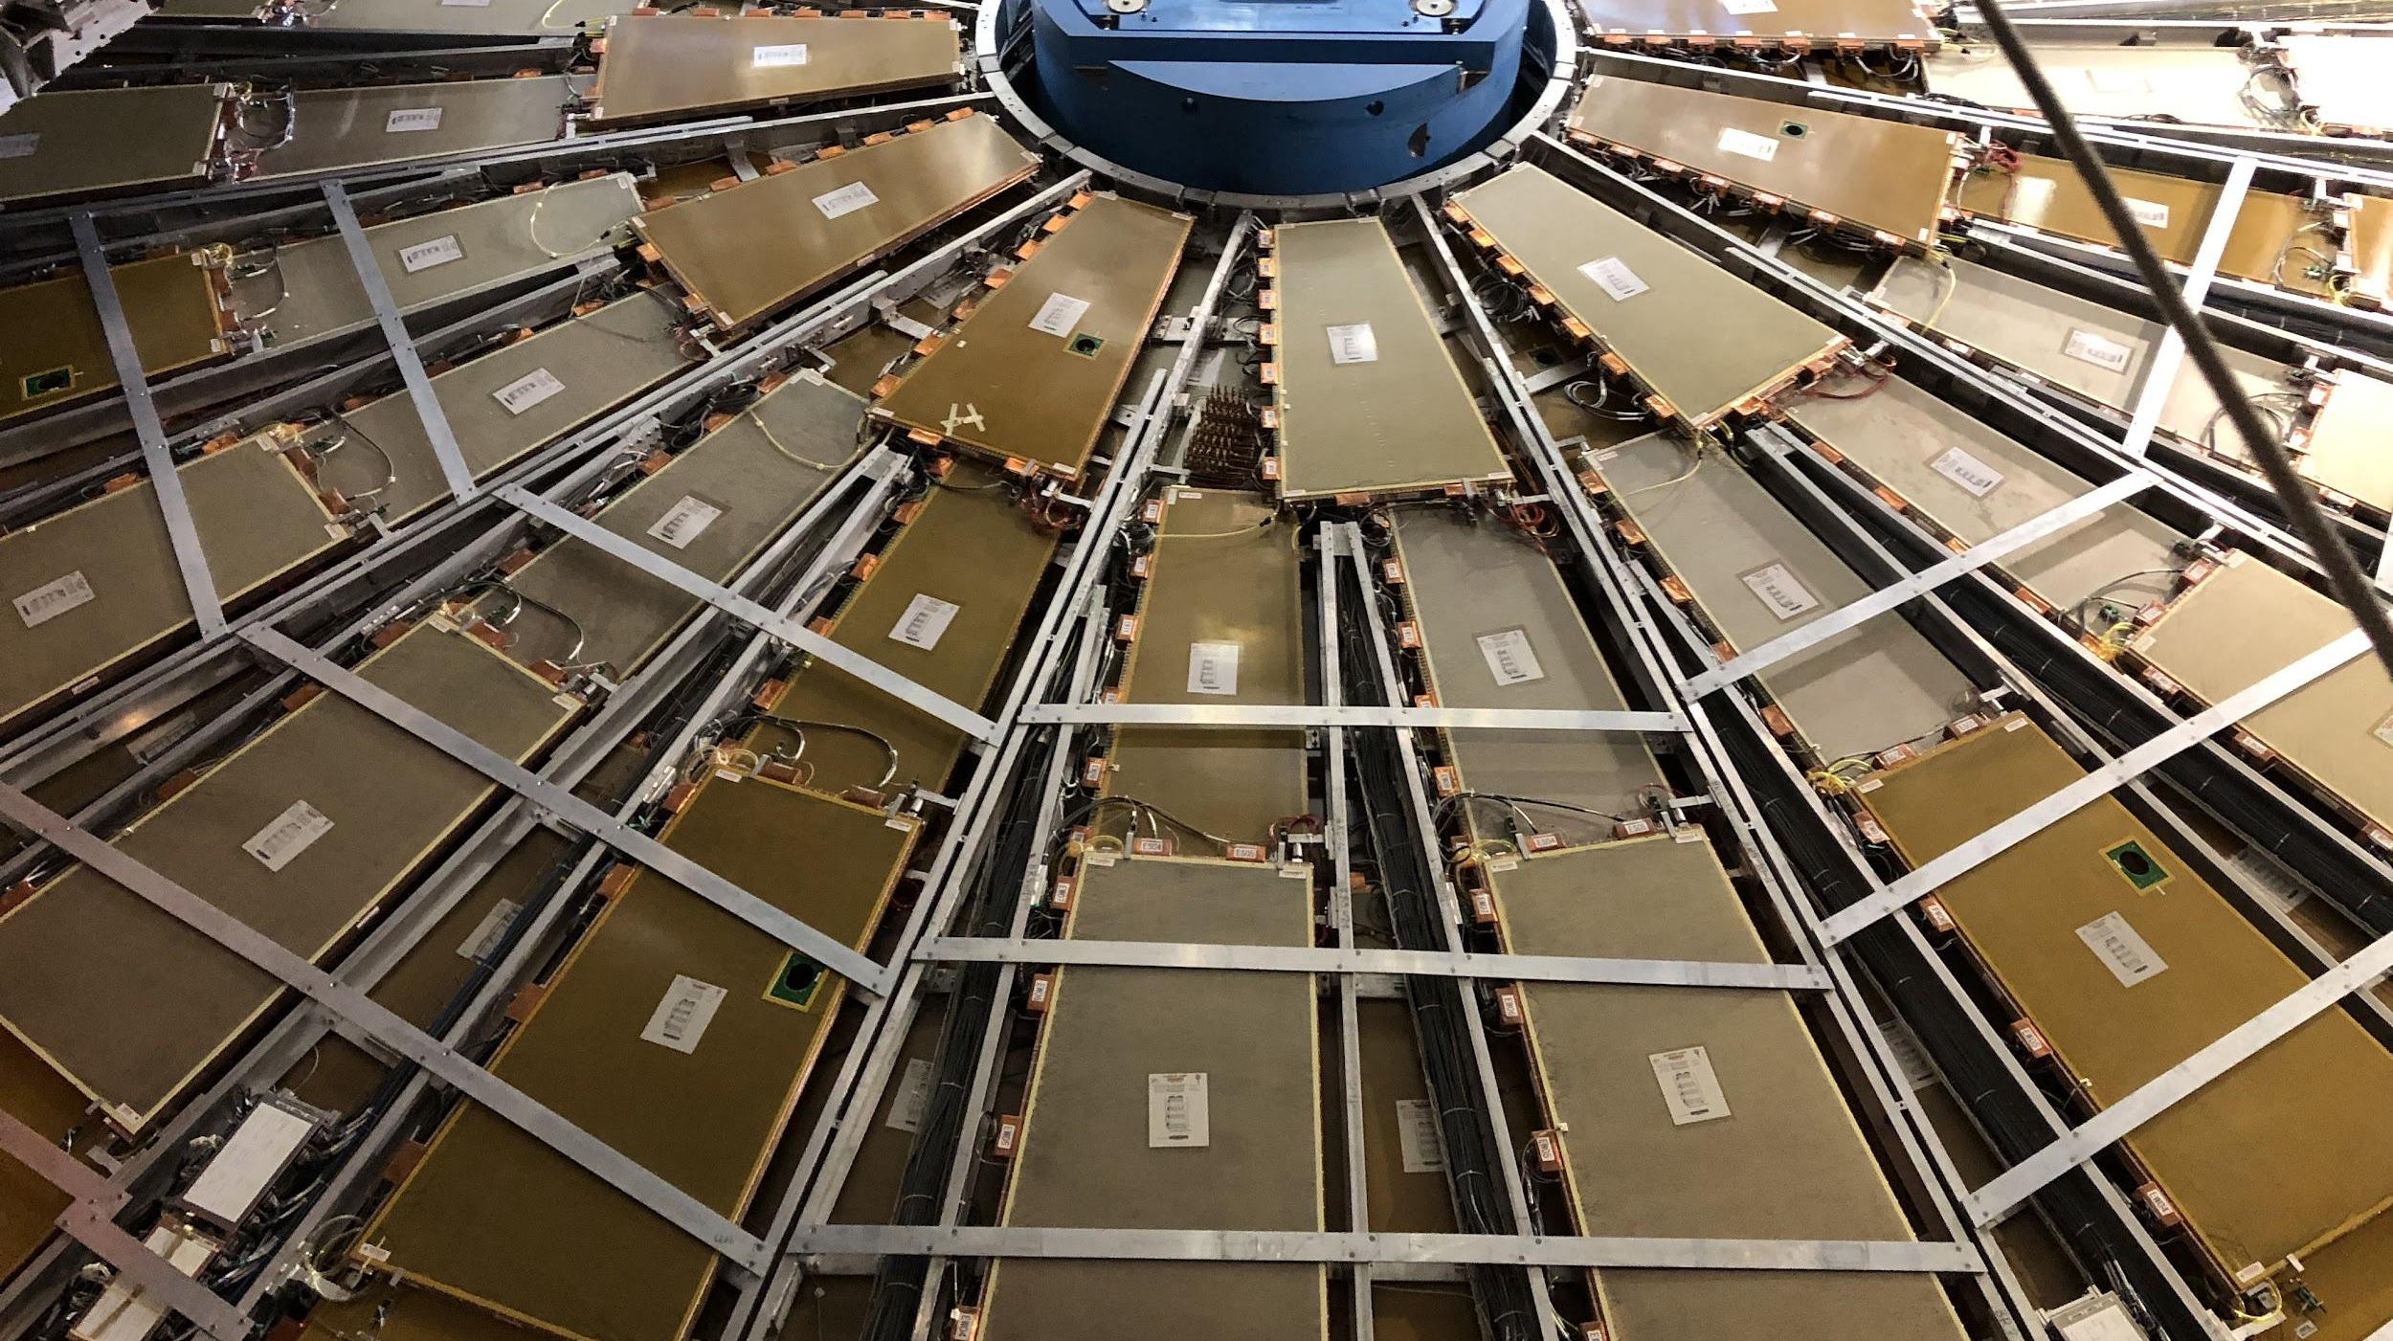

Maintenance Weekly
TileCal Op Meeting, 4 November 2021
Irakli Minashvili, Chris Thomas, Dawit Belayneh, Katie Hughes

Slide 2
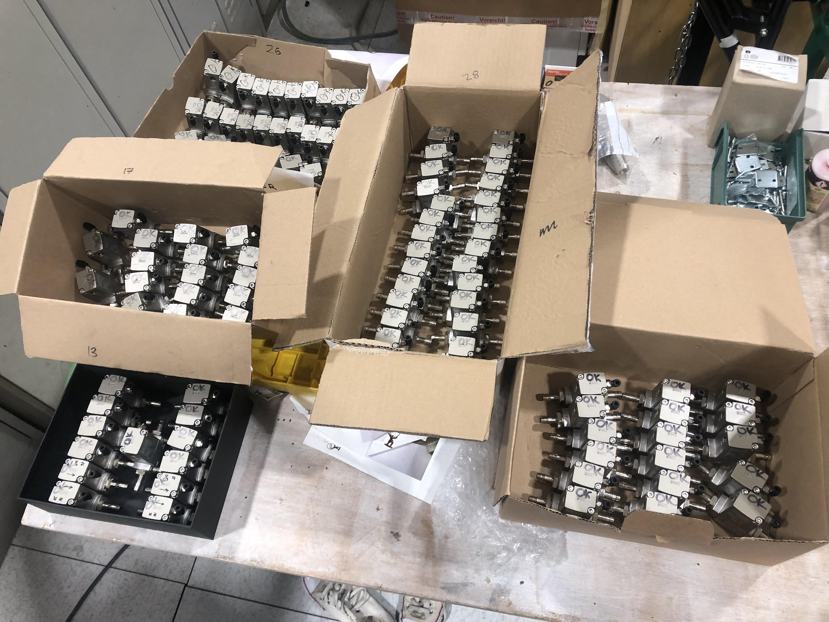
Isolation Valves Update
101 valves have been prepared and tested
Will start mounting on EBA this Tuesday (Nov. 9)

